Slide 1

CodeU Class 2 Welcome!
The class will start shortly
Reproduction and distribution of the presentation deck is prohibited

Slide 2
Agenda for today’s class
Recap of last class
01
02
Homework correction
To refresh our minds!
We’ll revise the hw to understand better
Topics of the day:
03
04
Practice time!
Learn how to code like a pro!
- Input()
- Conditionals: IF, ELIF, and ELSE statements
Wrap-up
Conclusion
05
06
CodeU Robot
Summary of what we’ve learned today
homework and questions

Slide 3
Continuation of Input()
01
Exercise 1: What year are you born in?
Step 1: Define a variable with your age using input()
Step 2: Calculate the difference between the current year and your age
Step 3: Print the result
Can we combine a Float value and an Integer in an equation?
01
Exercise 2: What is the exact weight of an ant colony?
You face a colony of ants. The average ant weighs about 0.225 pounds. There is about 300 ants in front of you. You have to calculate the EXACT total weight of the colony to be able to pass.
Step 1: Define a variable for the weight of the average ant using input()
Step 2: Define a variable for the number of ants in the colony using input()
Step 3: Calculate the product (multiply) of the two using float.
Step 4: Print the result.

Slide 4
Big Exercise
Create a VIP list for a CodeU Birthday Bash!
You are the host of the annual CodeU Birthday Bash! You are given the responsibility of creating a small VIP guest list. Unfortunately, there can only be 3 VIP guests this year. You must take down each guests NAME, AGE, and HEIGHT(cm) using INPUT() and PRINT(). Each guest needs to be displayed with all his\her attributes using PRINT().
Step 1: Define a variable for the first guest’s name using Input().
Step 2: Define a variable for the first guest’s age using Input()
Step 3: Define a variable for the first guest’s height using Input()
Step 4: Repeat steps 1-3 for the 2 other guests. Don’t forget to have different variable names for all 3 guests!
Step 5: Print each guests with their attributes in this format:
VIP #1
Name : Mandy
Age: 19
Height: 159 cm

Slide 5
Introduction to Conditionals
Definition: Conditionals perform different actions depending on whether a condition is true or false. It is the way a computer reacts based on a decision.
Example: If a scary dog decides to chase you, you will run. If it doesn’t chase you, you will most likely just look at it. If there is no dog, there won’t be anything to do.
IF Statement
Elif Statement
Else Statement
It decides whether an action will be executed or not. If the condition is True, then it will be executed.
It verifies if another possible condition other than the one defined in If is True. Short for Else If.
Else statement catches any other possibility. It decides what to do if the condition is False.
Example
If name == “cat”:
print(“Miaow!”)
Example
Elif name == “Cow”:
print(“MOOO!”)
Example
Else:
print(“That is not an animal”)

Slide 6
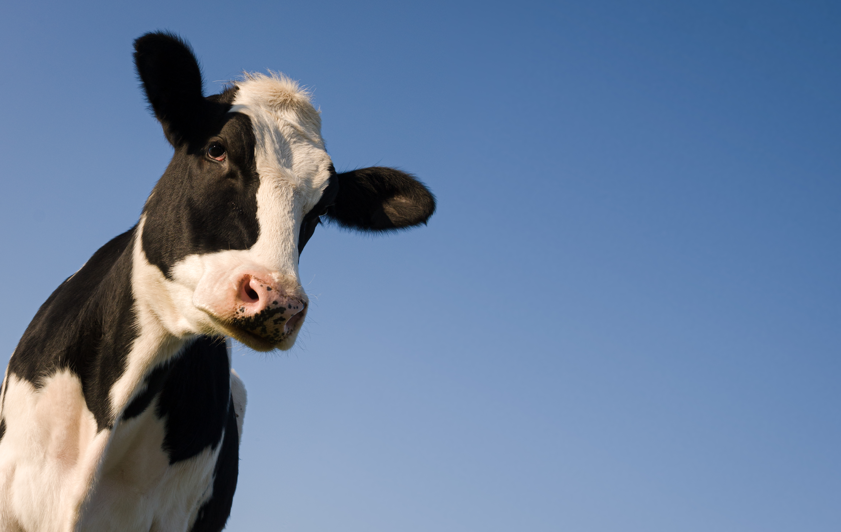
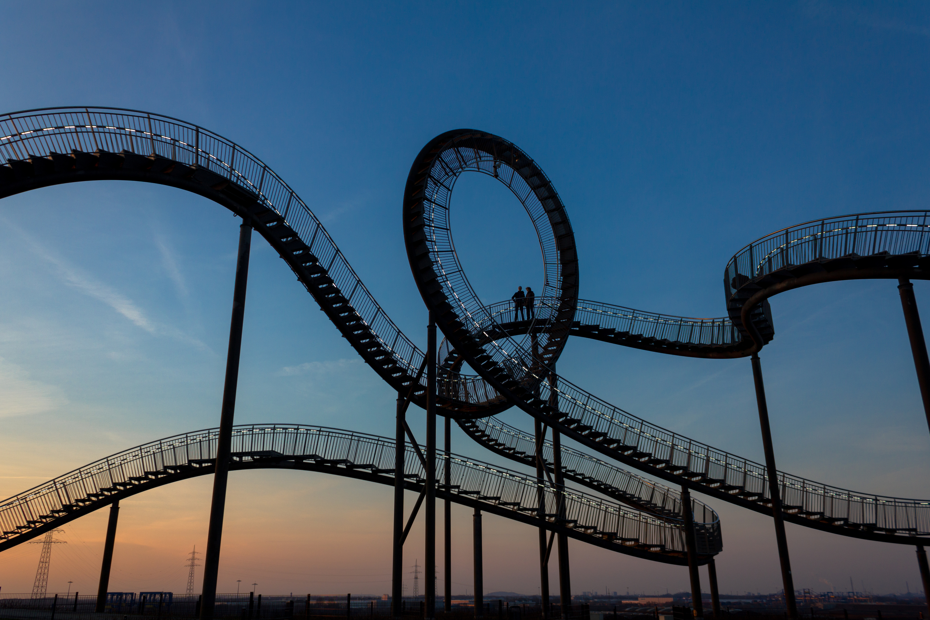
1
Exercise 1: Animal Sounds
3
Step 1: Define any animal as a variable
Exercise 1: Rollercoaster
Step 2: Write the first condition. This will be the animal sound the computer prints depending on the condition.
You are the entrance clerk at the worlds tallest rollercoaster. There is an age restriction of 15 years old. If the person entering is old enough, you can let them pass. If not, they can’t ride the rollercoaster.
Step 3: Write 2 other conditions.
Step 4: Write a FALSE condition that catches anything that isn’t in our conditions.
2
Step 1: Define the age of the person trying to enter as a variable using INPUT()
Exercise 2: is it 100?
Step 2: Write the first condition. This will determine if they are old enough to ride the rollercoaster.
Step 1: Define any number as a variable
Step 2: Write the first condition. This will determine if the number is bigger than 100.
Step 3: Write the other condition that determines if they are too young..
Step 3: Write the 2 other conditions that define if 1) the number is smaller than 100 2) the number is equal to 100
Step 4: Write a FALSE condition that catches anything that isn’t an age.
Step 4: Write a FALSE condition that catches anything that isn’t a number.

Slide 7
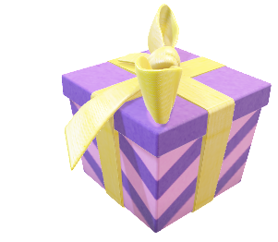
Homework: Create a Birthday Guessing Game!
Homework Description
For your birthday party, you have a VIP section. Only 2 people are allowed to TRY to enter. To enter, they must guess the correct number between 1 and 5 that YOU choose using INPUT().You must take down their First Names, Last Names, and their Guess.
1
Define a variable with a number between 1 and 5 and welcome guests to your party!
4
If they guess incorrectly, print() a message letting them know they cannot enter in VIP.
2
Take down the Name, Age, and Guess of each person that tries to enter the VIP section.
5
If the guess they entered is NOT a number, print() a message saying that their guess must be a number and is incorrect.
3
If they guess correctly, print() a message welcoming them to the VIP
6
Repeat for the steps 1-5 for the 2nd try. Once all 2 tries are done, print() a message saying that VIP entrance is closed!

Slide 8

Homework Solution: Birthday Guessing Game!
1
# Name your birthday party
myNumber = input("What is your number between 1 and 5?: ")
print("Welcome to my birthday party!")
# First Guest
print("Guest 1: ")
guest1_firstName = input("What is your first name: ")
guest1_guess = input("What is your guess?: ")
if int(guest1_guess) != int(myNumber):
print("Sorry, your guess was wrong! You cannot enter the VIP section :(")
elif int(guest1_guess) == int(myNumber):
print("Welcome to the VIP section " + guest1_firstName)
else:
print("Your guess is not a number!")
2
# Second Guest
print("Guest 2: ")
guest2_firstName = input("What is your first name: ")
guest2_guess = input("What is your guess?: ")
if int(guest2_guess) != int(myNumber):
print("Sorry, your guess was wrong! You cannot enter the VIP section :(")
elif int(guest2_guess) == int(myNumber):
print("Welcome to the VIP section " + guest2_firstName)
else:
print("Your guess is not a number!")
# Vip is closed message
print("Thank you for trying! The VIP entrance is now closed...")

Slide 9



Thank you!
Does anyone have any questions?
Next class: class 3!
Phone:
(438) 391-9106
Please contact us to make any change in the schedule for the next class.
Email:
siva.sri14@hotmail.com
hello@codeu.ca
Website:
https://www.codeu.ca/
Reproduction and distribution of the presentation deck is prohibited

